Slide 1

Machine Learning and Artificial Intelligence with Python
Sowmya S Sundaram

Slide 2

BASICS

Slide 3
What is Artificial Intelligence?

Slide 4
What is Artificial Intelligence?
Rational Thinking
Human Thinking
Rational Acting
Human Acting

Slide 5
What is Artificial Intelligence?
Representation
Learning
Components
Language Understanding
Reasoning
Perception

Slide 6
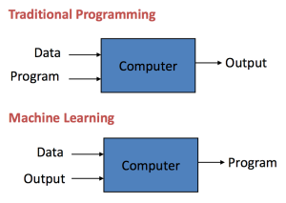
What is Machine Learning?

Slide 7
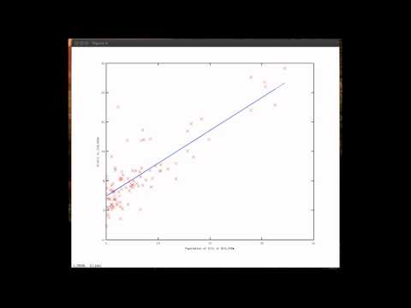
What is Machine Learning?

Slide 8
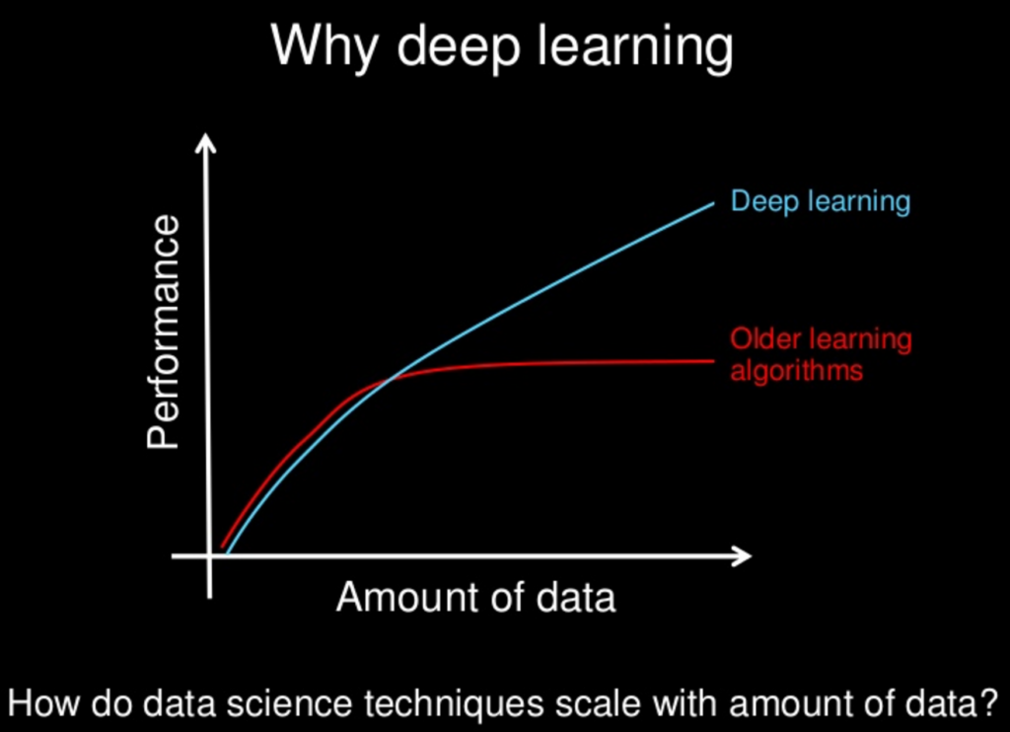
What is Deep Learning?

Slide 9
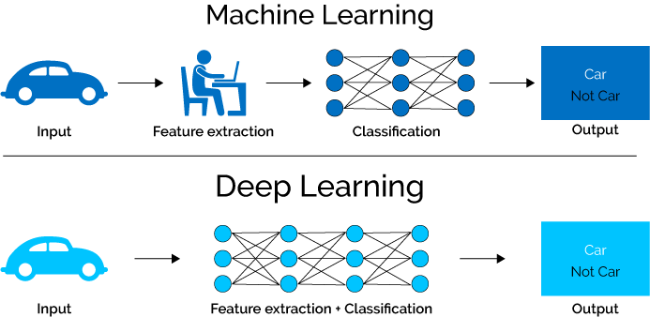
Machine Learning vs Deep Learning

Slide 10
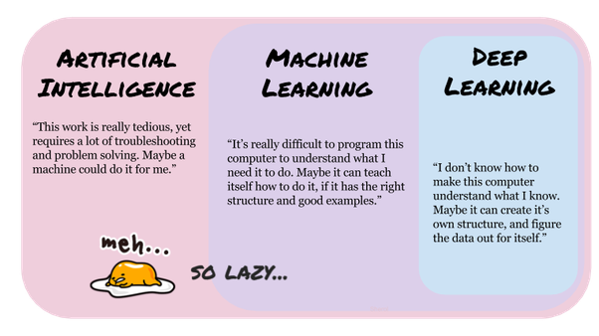
Summary of Basics

Slide 11
PYTHON IN ML

Slide 12
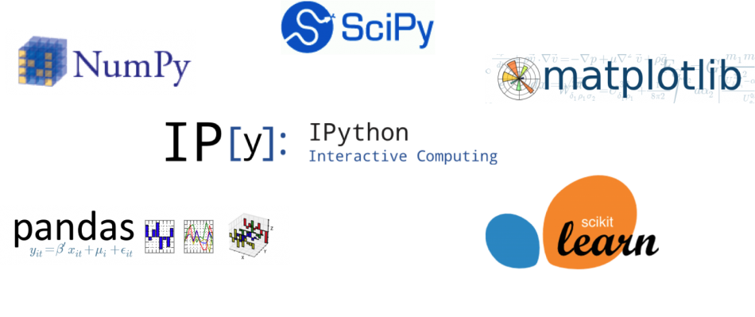

Slide 13
NumPy
It stands for 'Numerical Python'.
It is a library consisting of multidimensional array objects and a collection of routines for processing of array.
Functionalities
Mathematical and logical operations on arrays.
Operations related to linear algebra.
Random number generation

Slide 14
NumPy
import numpy as np a = np.array([1, 2, 3]) print(a.shape) # Prints "(3,)"

Slide 15
NumPy
import numpy as np x = np.array([[1,2],[3,4]], dtype=np.float64) y = np.array([[5,6],[7,8]], dtype=np.float64)
print(np.multiply(x, y)) # Elementwise product
print(np.dot(x, y)) # Vector product

Slide 16
Matplotlib
Visualization library
It consists of several plots like line, bar, scatter, histogram etc.

Slide 17
Matplotlib
from matplotlib import pyplot as plt
x = [5, 2, 9, 4, 7] # x-axis values
y = [10, 5, 8, 4, 2] # Y-axis values
plt.scatter(x, y) #scatterplot
plt.show() # function to show the plot

Slide 18
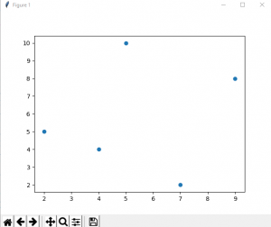
Matplotlib

Slide 19
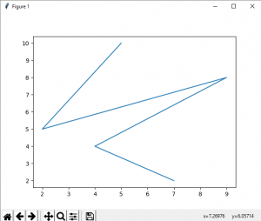
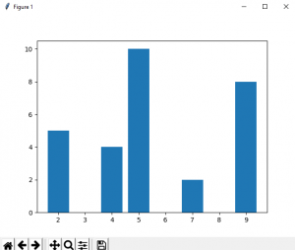
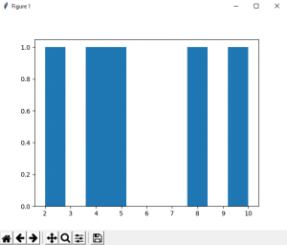
Matplotlib

Slide 20
Sklearn
Implements machine learning algorithms
Vast resource

Slide 21
Sklearn
# Sample Decision Tree Classifier
from sklearn import datasets
from sklearn import metrics
from sklearn.tree import DecisionTreeClassifier
# load the iris datasets
dataset = datasets.load_iris()

Slide 22
Sklearn
# fit a model to the data
model = DecisionTreeClassifier()
model.fit(dataset.data, dataset.target)
print(model)
# make predictions
expected = dataset.target
predicted = model.predict(dataset.data)

Slide 23
Sklearn
# summarize the fit of the model
print(metrics.classification_report(expected, predicted))
print(metrics.confusion_matrix(expected, predicted))

Slide 24
SciPy
SciPy is a scientific python package

Slide 25
SciPy
from scipy.special import comb
#find combinations of 5, 2 values using comb(N, k)
com = comb(5, 2, exact = False, repetition=True)
print(com)
output: 15.0

Slide 26
PYTHON IN DL

Slide 27


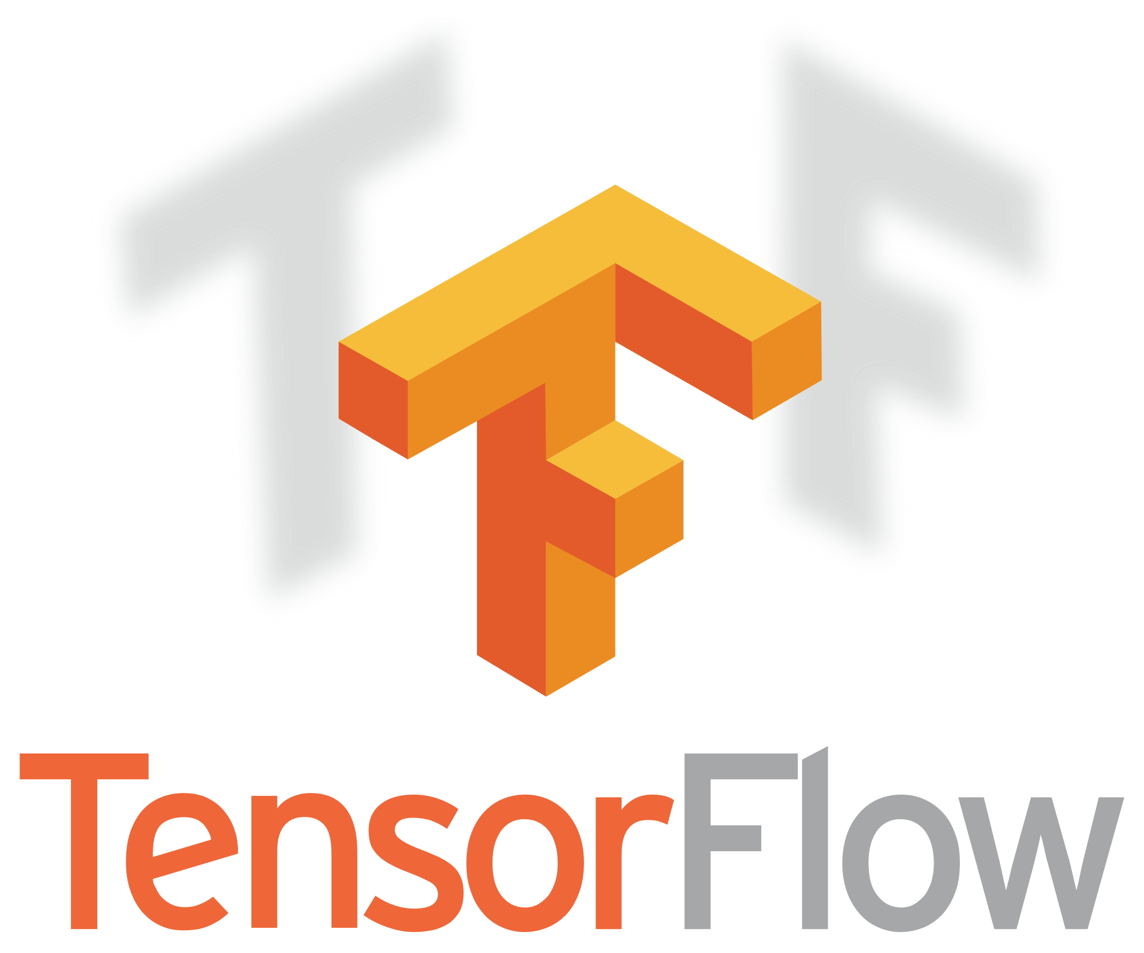


Slide 28
Anaconda
Anaconda® is a package manager, an environment manager, a Python/R data science distribution, and a collection of over 1,500+ open source packages.
Anaconda is free and easy to install, and it offers free community support.

Slide 29
Jupyter
Great tool for creating python projects
jupyter notebook
jupyter notebook test.ipynb

Slide 30
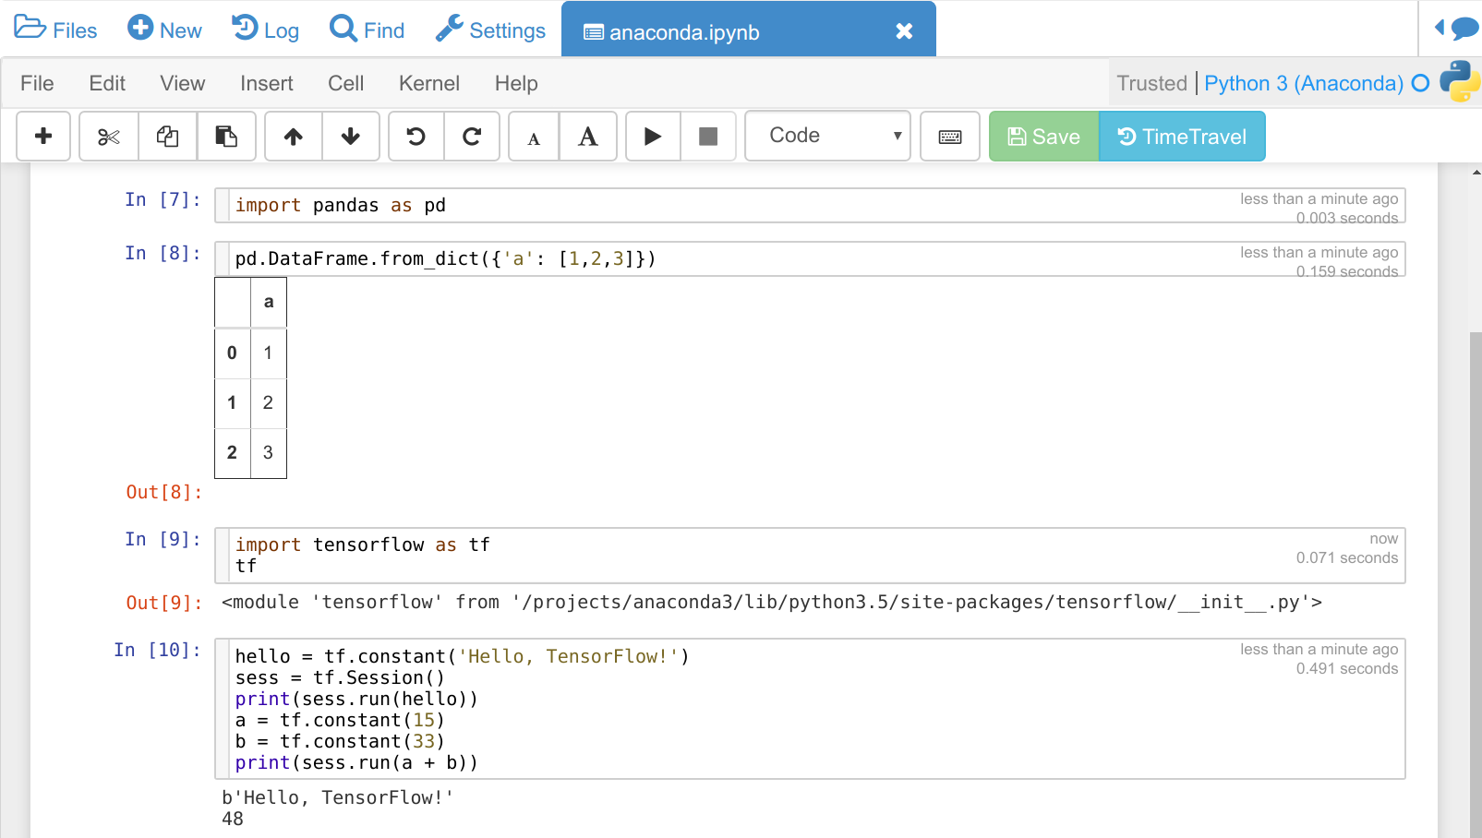
Jupyter

Slide 31
Tensorflow
TensorFlow is an open-source software library for dataflow and differentiable programming across a range of tasks.
TensorFlow provides stable Python APIs

Slide 32
Keras
Keras is an open-source neural-network library written in Python.
It is capable of running on top of TensorFlow, Microsoft Cognitive Toolkit, Theano, or PlaidML.
Designed to enable fast experimentation with deep neural networks, it focuses on being user-friendly, modular, and extensible.

Slide 33
Keras
Keras contains numerous implementations of commonly used neural-network building blocks such as layers, objectives, activation functions, optimizers.
It also has a host of tools to make working with image and text data easier.

Slide 34
APPLICATIONS OF AI

Slide 35



Computer Vision

Slide 36
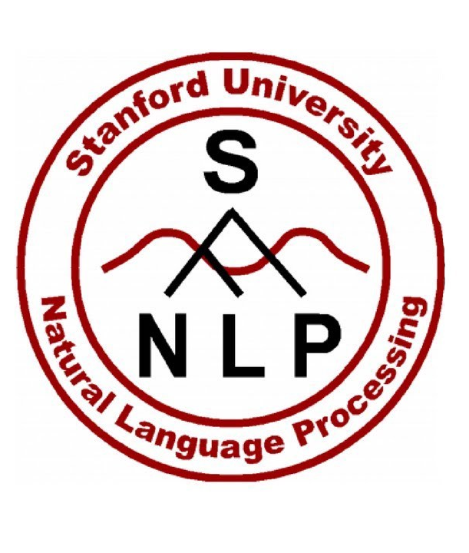


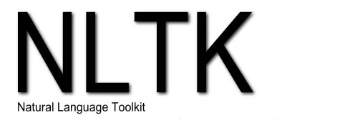
Natural Language Processing

Slide 37

Chatbots

Slide 38


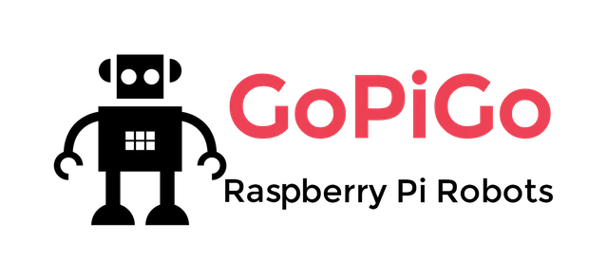
Robotics

Slide 39
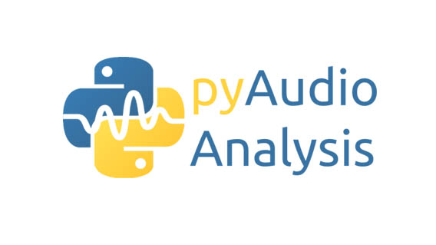

Speech

Slide 40
HANDS ON

Slide 41
Resources
Analytics Vindhya
Coursera
Udacity
EdX
Linear Algebra
Probability
Calculus

Slide 42
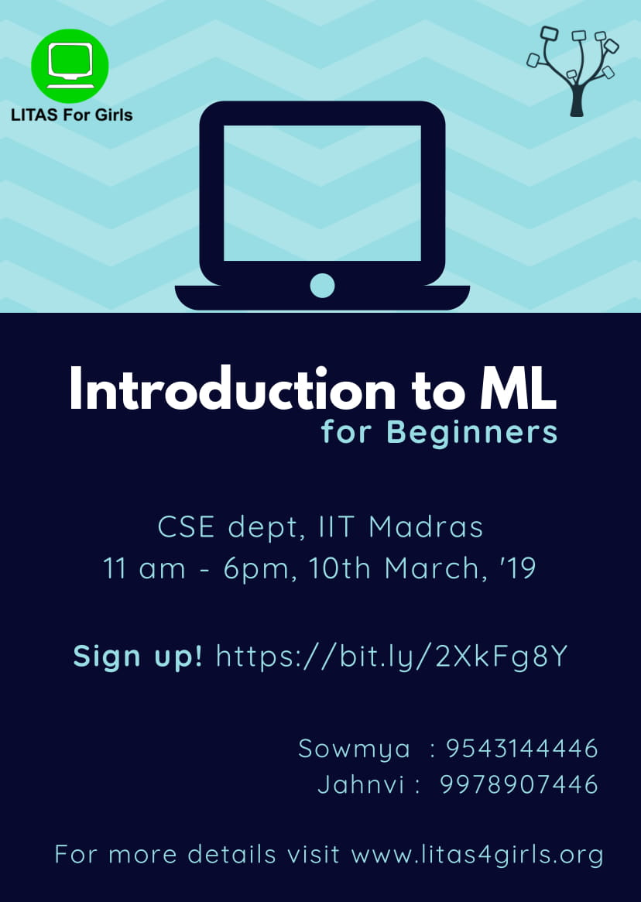

Slide 43
Questions?

